Slide 1
Web Development

Slide 2
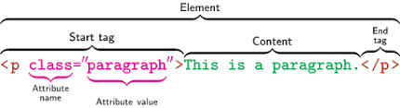
HTML: HyperText Markup Language
HTML is a markup language that defines the structure of your content.
HTML is not case sensitive language
Element
An HTML element is defined by a start tag, some content, and an end tag.
Tag
90% tags comes with the closing pair . Ex:- P, Div etc…..
some of them are not needed to be closed. Ex:- Br, Input, Hr
Attributes
id,name,type attributes always writes in opening tags

Slide 3
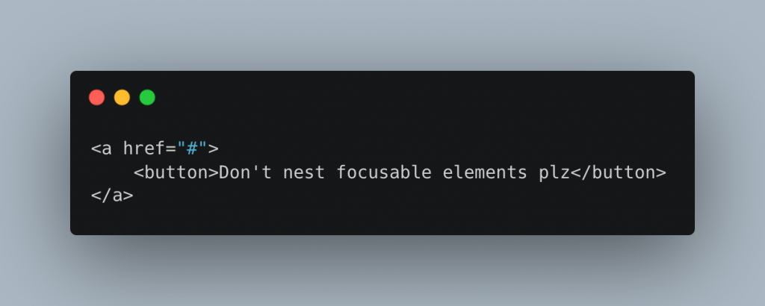
Nesting Elements
You can put elements inside other elements too — this is called nesting.

Slide 4
HTML Semantic Elements
benefits of semantic
Search engines will consider its contents as important keywords to influence the page's search rankings (see SEO)
Screen readers can use it as a signpost to help visually impaired users navigate a page
Finding blocks of meaningful code is significantly easier than searching through endless divs with or without semantic or namespaced classes
Suggests to the developer the type of data that will be populated
Semantic naming mirrors proper custom element/component naming

Slide 5
Cascading Style Sheets (CSS)
Cascading Style Sheets (CSS) is a stylesheet language used to describe the presentation of a document written in HTML. CSS describes how elements should be rendered on screen, on paper, in speech, or on other media.
Type of CSS
Inline CSS
<p style="color:#009900;">GeeksForGeeks</p>
Internal CSS
<style>
.main {
text-align: center;}
</style>

Slide 6
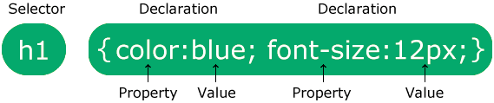
External CSS
<link rel="stylesheet" href="style.css">
CSS Syntax
Universal selectors
*{
margin: 0;
}
Simple selectors
name, id, class

Slide 7
Group Selectors
h1, h2, p { text-align: center; color: red; }
Attribute selectors
a[href="https://example.com"] {
}
Decedant selectors
ul.menu a{
text-decoration: none;
}
Child selectors
.menu>li>a{
text-decoration: none;
}
Adjacent Sibling Selectors
h2+p{
text-transform: uppercase;
}

Slide 8
General Sibling Selectors
h2~p{
text-transform: uppercase;
}
Pseudo-elements selectors
p::first-letter {
font-size: 36px;
}
Pseudo-class selectors
a:visited {
color: green;
}

Slide 9
CSS Grid Layout
The CSS Grid Layout Module offers a grid-based layout system, with rows and columns, making it easier to design web pages without having to use floats and positioning.
Property
grid-template-rows : Specifies the size of the rows.
grid-template-columns : This specifies the size of the columns.
grid-template-areas : This specifies the grid layout using named items.
grid-auto-rows : This specifies the auto size of the rows.
grid-auto-columns : This specifies the auto size of the columns.
grid-auto-flow : This specifies how to place auto-placed items, and the auto size of the row.

Slide 10
CSS media queries
CSS media queries are a key component of responsive design that allow you to apply CSS styles depending on the presence or value of device characteristics.
It's common to apply a media query based on the viewport size so that layout choices can be made for devices with different screen sizes. For example, you may have a smaller font size for devices with small screens, increase the padding between paragraphs when a page is viewed in portrait mode, or increase the size of buttons on touchscreens.
Media queries can be used to check many things, such as:
width and height of the viewport
width and height of the device
orientation (is the tablet/phone in landscape or portrait mode?)
resolution

Slide 11
CSS animation
CSS allows animation of HTML elements without using JavaScript or Flash! @keyframes animation-name animation-duration animation-delay animation-iteration-count animation-direction animation-timing-function animation-fill-mode animation

Slide 12
CSS Framework
Bootstrap is the most popular HTML, CSS and JavaScript framework for developing a responsive and mobile friendly website.
It is a front-end framework used for easier and faster web development.
It includes HTML and CSS based design templates for typography, forms, buttons, tables, navigation, modals, image carousels and many others.
It facilitates you to create responsive designs.

Slide 13
Figma for developers
Figma design is for people to create, share, and test designs for websites, mobile apps, and other digital products and experiences.
No, Figma does not require coding.
Figma allows the team to collaborate in real-time, making the process easier. This feature makes the job more transparent because each team member can see the modifications done by their teammate. As it is a cloud-based website creation program, everything is available on the screen.

Slide 14
What are CSS Animations
An animation lets an element gradually change from one style to another.
You can change as many CSS properties you want, as many times as you want.
To use CSS animation, you must first specify some keyframes for the animation.
Keyframes hold what styles the element will have at certain times.
The @keyframes Rule
When you specify CSS styles inside the @keyframes rule, the animation will gradually change from the current style to the new style at certain times.
To get an animation to work, you must bind the animation to an element.
The following example binds the "example" animation to the <div> element. The animation will last for 4 seconds, and it will gradually change the background-color of the <div> element from "red" to "yellow“
@keyframes example { 0% {background-color: red;} 25% {background-color: yellow;} 50% {background-color: blue;} 100% {background-color: green;} }

Slide 15
CSS Pre-Processors
We can’t use sass file in html.
Browsers can’t understand sass code
SCSS(Sassy CSS): The files using this syntax use .scss extension.
Indented syntax (referred to as just “sass”): older syntax, Files using this syntax use .sass extension.
Variables: Variables can be used to store CSS values that may be reused. To declare a variable in SASS, the ‘$’ character is used. For eg, $v_name.
Nesting: SASS allows CSS rules to be nested within each other, which follows the same visual hierarchy of HTML. For eg. CSS property can be used to the <li> tag nested inside the div tag.
Mixins: Mixins helps to make a set of CSS properties reusable i.e. it saves one code and use it again and again. It can be included in other CSS rules by using the @include directive.

Slide 16
import
Sass Importing Files
Just like CSS, Sass also supports the @import directive.
The @import directive allows you to include the content of one file in another.
The CSS @import directive has a major drawback due to performance issues; it creates an extra HTTP request each time you call it. However, the Sass @import directive includes the file in the CSS; so no extra HTTP call is required at runtime!
extend
The @extend directive lets you share a set of CSS properties from one selector to another.
The @extend directive is useful if you have almost identically styled elements that only differ in some small details.
The following Sass example first creates a basic style for buttons (this style will be used for most buttons). Then, we create one style for a "Report" button and one style for a "Submit" button. Both "Report" and "Submit" button inherit all the CSS properties from the .button-basic class, through the @extend directive

Slide 17
Scss syntax
nav{
a{
margin:5px;
padding:5px;}
}
Sass syntax
nav
a
margin:5px
padding:5px

Slide 18
Version Control - GIT
Git is a distributed version control system that enables software development teams to have multiple local copies of the project's codebase independent of each other.
Version control also enables frictionless communication, change, and reproducibility between developers and other team members.
With version control, you're able to track and merge branches, audit changes, and enable concurrent work to accelerate software delivery
Git is a distributed version control system that enables software development teams to have multiple local copies of the project's codebase independent of each other. These copies, or branches, can be created, merged, and deleted quickly, empowering teams to experiment, with little compute cost, before merging into the main branch (sometimes referred to as the master branch).

